Slide 1

CAR FEATURE IMPACT ANALYSIS

Slide 2



Roadmap
Insights
Approach
Project Description
Tech-Stack Used
Results

Slide 3

Project Description
1.

Slide 4

Project Description
Over the years demand for automobiles has surged, It led to a rise in competition and innovation among companies on the global level to meet the demands of the changing consumer landscape.
As the innovation took place consumer interest in Hybrid and Electric cars has increased nevertheless, Petrol and Diesel cars remain dominant in the marketplace.
Being a Data Analyst, I was supposed to figure out how can a car manufacturer optimise pricing and product development decisions to maximise profitability while meeting consumer demand?
This can be figured out by executing EDA on Dataset, performing Regression Analysis and finding the relationship between different variables
To carry out all such operations, I had been delineated with a CAR FEATURE IMPACT DATASET to carry out all the operations.
Moreover, the Dataset consisted of 11915 Tuples and 16 Attributes.

Slide 5
Approach
2

Slide 6

Our process is easy
Cleaning the Dataset
Removing duplicate & null values.
Dropping Unnecessary attributes.
Formatting the data into a consistent Data
Analysis
1
Analyzing the relationship between different variables.
By implementing the regression analysis.
Performing the appropriate operations using features such as Pivot Table, and Conditional Formatting to derive useful insights from the data.
Visualizing the achieved results using Charts and Graphs to draw useful inferences.
2

Slide 7
Tech – Stack Used
3

Slide 8


Tech – Stack Used
Insert your content

Slide 9
RESULTS
4
Let’s start with the set of results

Slide 10
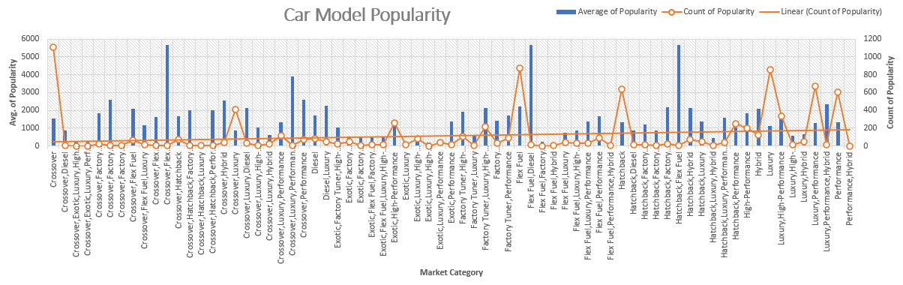
Insights Required: How does the Popularity of a Car Models vary across different market Categories?..
1.
Based on the data, It is clear that the most popular Market Categories are Crossover-Flex Fuel, Diesel-Flex Fuel and Hatchback-flex fuel. Furthermore, there is a strong positive correlation between Market Category and popularity.

Slide 11
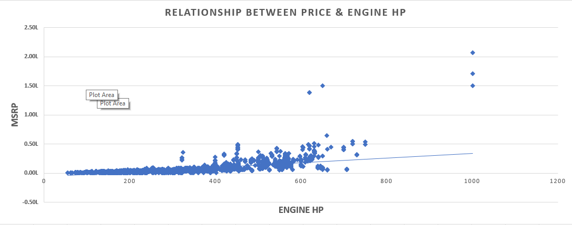
Insights Required: What is the Relationship between a Car’s Engine Power and its price?
2.
There is a Positive Relationship between Engine HP & MSRP as the Engine HP increases simultaneously MSRP starts surging.

Slide 12
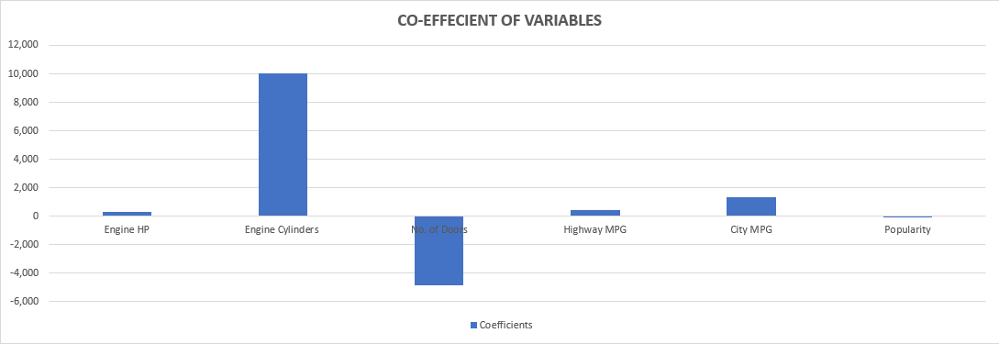
Insights Required: Which of the Car feature is most important in determining a Car’s Price?
3.
While determining the Car’s Price features such as Engie Cylinders is the most important factor in determining the Car’s Price. Furthermore, City MPG, Highway MPG & Engine HP play a Vital role, the least important feature in determining the Car Price is “No. of Doors & Popularity”.

Slide 13
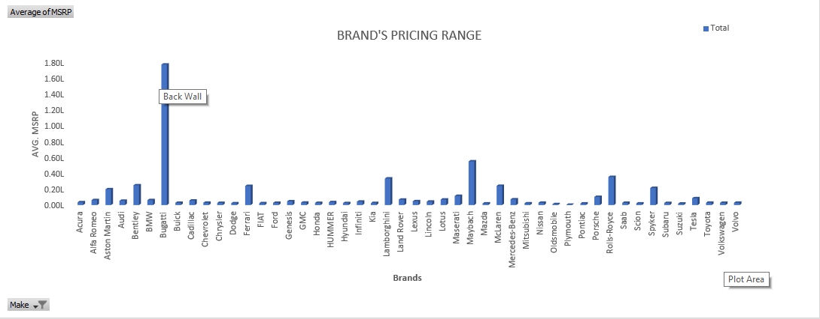
Insights Required: How does the average price of a Car vary across different manufacturers?
4.
”Bugatti” has the highest pricing among all the brands, while “Plymouth” has the lowest pricing for their automobile models. It's quite interesting to see such a big difference in pricing between these two brands.

Slide 14
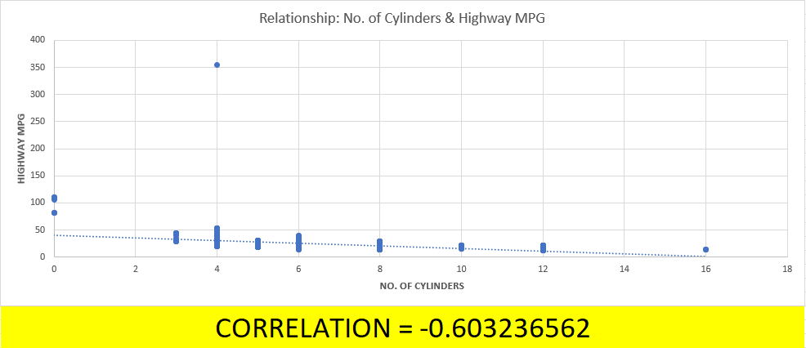
Insights Required: What is the relationship between Fuel efficiency and the No. of cylinders in a Car’s Engine?
5.
It seems that there is a highly negative relationship between the “Number of Cylinders” and ” MPG”, As the number of cylinders increases, the MPG tends to decrease.

Slide 15
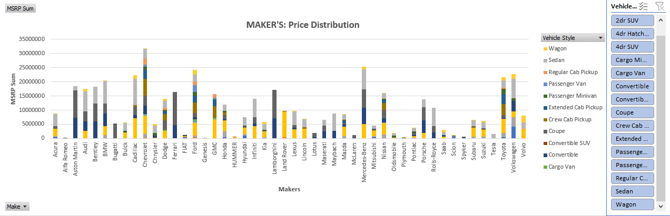
Insights Required: How does the distribution of Car price’s vary by brand and body style?
6.
Amongst all the automobile manufacturers Chevrolet has the highest price distribution. The 4dr SUV seems to have the major portion of this Chevrolet price distribution. On the other hand, the brand Genesis has the lowest price distribution.

Slide 16
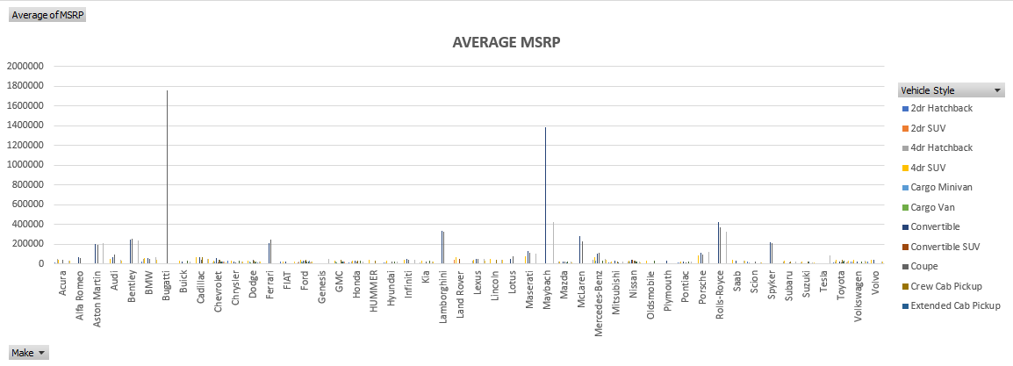
Insights Required: Which Car brands have the highest & lowest average MSRP. How does this vary by body style?
7.
Bugatti has the highest average price in the Coupe vehicle style whereas Genesis has the lowest average MSRP.

Slide 17
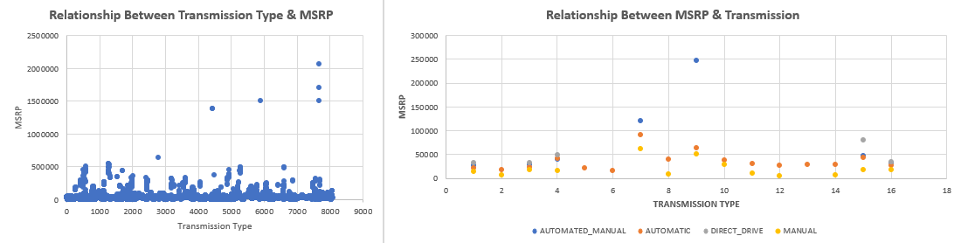
Insights Required: How do the different features such as transmission type affect the MSRP, and how does this vary by body style?
8.
After analyzing the relationship OF MSRP with Transmission type, It seems that transmission types such as AUTOMATED_MANUAL, AUTOMATIC & DIRECT_DRIVE have a positive relationship with transmission type and MSRP, whereas the MANUAL Transmission type has no relationship with Transmission & and MSRP.

Slide 18
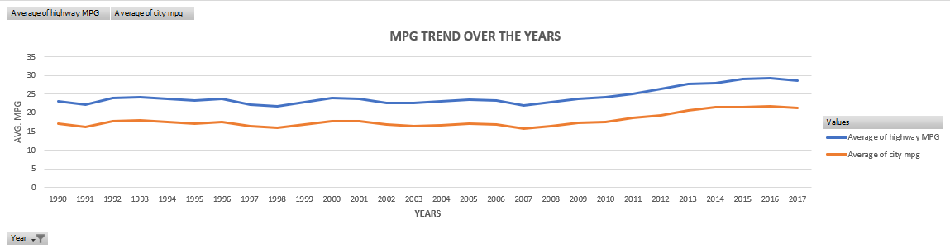
Insights Required: How does the fuel effeciency of cars vary across different body styles and model years?
9.
While performing the analysis of data. It’s been discovered that the trend of fuel efficiency was steady with slight ups and downs till 2007. Henceforth year 2007 trend of fuel efficiency started taking a positive surge.

Slide 19
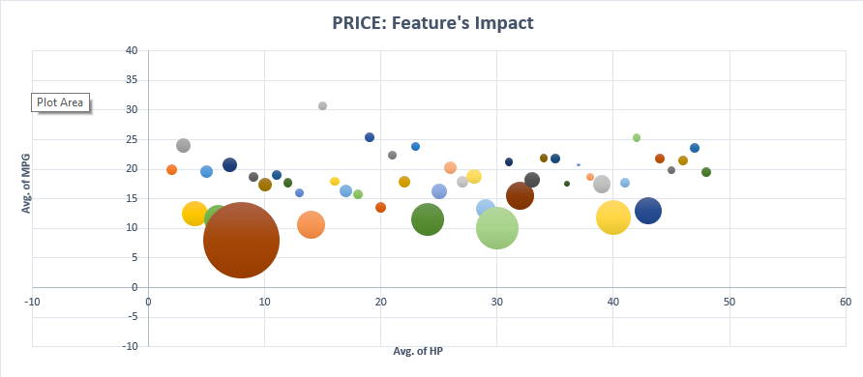
Insights Required: How does the car’s horsepower, MPG and price vary across different brands?
10.

Slide 20
Insights
The analysis reveals several key insights into the automotive market
Popular market categories, such as Crossover-Flex Fuel and Hatchback-Flex Fuel, indicate consumer preferences, guiding manufacturers to focus on these segments.
Consumers value higher horsepower.
Features like Engine Cylinders, City MPG, and Highway MPG play crucial roles in determining car prices, emphasizing the need for manufacturers to prioritize these aspects.
The upward trend in fuel efficiency post-2007 encourages manufacturers to prioritize fuel-efficient technologies.
These findings offer valuable guidance for manufacturers to make informed decisions about market positioning, features and product development.

Slide 21



Thanks!
Tushar Agarwal
LinkedIn
Tushar.agarwal4201@gmail.com

